Slide 1
Microsoft Cognitive Services
Amplifying human ingenuity
<Speaker Name>
<Date>
Notes:
So, what are Cognitive Services? Cognitive Services are a collection of artificial intelligence APIs, and we believe in democratizing artificial intelligence. So what that means is, regardless of your skill level -- whether you're a high school student running your first program or working in industry or in a giant enterprise -- that you should be able to use our APIs incredibly quickly in a matter of minutes.
And regardless of your platform -- whether you're on Android or IOS or Windows, or making a website -- all of our APIs are rest APIs, which means you can call them as long as you have an Internet connection. And so that's pretty huge because what we're doing is making it so that everyone can build these smarter, more context-aware applications.
The technology used in our APIs is the same technology that powers our products today. And so, when you think of things like the Bing search APIs, it's the same technology from Bing.
Today I’m going to talk with you about the entire collection spanning vision, speech, language, knowledge, and search.
The other things that I want to point out is that you can get started for free with all of the APIs, but we do have pricing available for a number of them, which are in public preview on Azure.
The other piece is the developer resources. So, all of our documentation is on the website and actually in GitHub as well, so we do welcome community submissions. We have a set of SBKs that are also available on GitHub where we welcome poll requests and post everything on there. The SBKs vary from API to API, but they are all included in this one repository for people to see.
And then we have three different communities that we support. We have our MSDN forums, our Stack Overflow, and we have User Voice that we use for feedback requests.

Slide 2






Microsoft Cognitive Services Give your apps a human side
Vision
From faces to feelings, allow your apps to understand images and video
Speech
Hear and speak to your users by filtering noise, identifying speakers, and understanding intent
Language
Process text and learn how to recognize what users want
Knowledge
Map complex information and data in order to solve specific tasks
Search
Access billions of web pages, images, videos, and news with the power of Bing
Labs
An early look at emerging Cognitive Services technologies: discover, try, and give feedback on new technologies before general availability

Slide 3








Why Microsoft Cognitive Services?
Easy
Flexible
Tested
Roll your own with REST APIs
Simple to add: just a few lines of code required
Integrate into the language and platform of your choice
Breadth of offerings helps you find the right for your app
Bring your own data for your custom experience
Built by experts in their field from Microsoft Research, Bing, and Azure Machine Learning
Quality documentation, sample code, and community support
Get a key,
Build
Notes:
Why choose these APIs ? They work, and it’s easy.
Easy: The APIs are easy to implement because of the simple REST calls. Being REST APIs, there’s a common way to implement and you can get started with all of them for free simply by going to one place, one website, www.microsoft.com/cognitive. (You don’t have to hunt around to different places.)
Flexible: We’ve got a breadth of intelligence and knowledge APIs so developers will be able to find what intelligence feature they need; and importantly, they all work on whatever language, framework, or platform developers choose. So, devs can integrated into their apps—iOS, Android, Windows—using their own tools they know and love (such as python or node.js, etc.).
Tested: Tap into an ever-growing collection of powerful AI algorithms developed by experts. Developers can trust the quality and expertise build into each by experts in their field from Microsoft’s Research organization, Bing, and Azure machine learning and these capabilities are used across many Microsoft first party products such as Cortana, Bing and Skype.

Slide 4
Microsoft Cognitive Services updates
Vision
Speech
Language
Knowledge
Search
Labs
Video Indexer
Speaker Recognition
Text Analytics
QnA Maker
Bing Entity Search
Project Gesture
Computer Vision
Bing Speech
Bing Spell Check
Custom Decision
Bing Autosuggest
Project Local Insights
Face
Custom Speech
Translator Text
Bing Search
Project Academic Knowledge
Emotion
Translator Speech
Language Understanding (LUIS)
Web Search
Project Entity Linking
Content Moderator
Unified Speech
Image Search
Project Knowledge Exploration
Custom Vision
Speech to Text w. Custom Speech
News Search
Project Event Tracking
Text to Speech w. Custom Voice
Video Search
Project Answer Search
Speech Translation w. Custom Translator
Bing Statistics add-in
Project URL Preview
Bing Visual Search
Project Anomaly Finder
Bing Custom Search
Project Conversation Learner
Project Personality Chat
Notes:
Notes about CS evolution
Emotion is in Paid preview on Azure. As Face API now integrates Emotion recognition, we recommend using Face API going forward.

Slide 5





Cognitive Services capabilities Infuse your apps, websites, and bots with human-like intelligence
Vision
Speech
Language
Knowledge
Search
Object, scene, and activity detection
Face recognition and identification
Celebrity and landmark recognition
Emotion recognition
Text and handwriting recognition (OCR)
Video metadata, audio, and keyframe extraction and analysis
Explicit or offensive content moderation
Custom image recognition
Speech transcription (Speech-to-text)
Speech Synthesis (Text-to-speech)
Real-time speech translation
Speaker identification and verification
Custom Speech models for transcription and translation
Custom voice
Language detection
Text sentiment analysis
Key phrase extraction
Entity recognition
Spell checking
Explicit or offensive text content moderation, PII detection
Text translation
Customizable text translation
Contextual language understanding
Q&A extraction from unstructured text
Knowledge base creation from collections of Q&As
Semantic matching for knowledge bases
Customizable content personalization learning
Ad-free web, news, image, and video search results
Trends for video, news
Image identification, classification and knowledge extraction
Identification of similar images and products
Named entity recognition and classification
Knowledge acquisition for named entities
Search query autosuggest
Ad-free custom search engine creation
Notes:
Vision: Image-processing algorithms to smartly identify, caption and moderate your pictures
Computer vision: Distill actionable information from images
Content Moderator: Automatically moderate potentially offensive images, text and videos
Customer Vision Service: Train a web service to recognize specific content in images
Face: Identify human faces and emotions in images
Video indexer: Easily extract insights from your videos to enrich your applications
Speech: Convert spoken audio into text, use voice for verification, or add speaker recognition to your app
Bing Speech: Convert speech to text and text to speech
Speaker Recognition: Use speech to identify and authenticate individual speakers
Custom Speech Service: Overcome speech recognition barriers like speaking style, background noise, and vocabulary
Translator Speech: Easily conduct real-time speech translation on your app
Language: Enable your apps to process natural language with pre-built scripts, evaluate sentiment and learn how to recognize what users want
Bing Spell Check: Add spell checking functionality to your app
Language Understanding (LUIS): Add language understanding intelligence to your apps with minimal effort
Linguistic Analysis: Easily parse complex text with language analysis
Text Analytics: Easily evaluate sentiment, language, and key phrases to understand what users want
Translator Text: Easily conduct machine translation for 60+ languages
Knowledge: Map complex information and data in order to solve tasks such as intelligent recommendations and semantic search
Knowledge Exploration Service: Enable interactive search experiences over structured data via natural language inputs
Entity Linking Service: Power your app's data links with named entity recognition and disambiguation
Academic Knowledge: Tap into the wealth of academic content in the Microsoft Academic Graph using the Academic Knowledge API
QnA Maker: Distill information into an easy-to-navigate FAQ for bot services
Customer Decision Service: Create custom experiences with adaptive, contextual decision-making
Search: Add Bing Search APIs to your apps and harness the ability to comb billions of webpages, images, videos, and news with a single API call
Bing Autosuggest: Give your app intelligent autosuggest options for searches
Bing News Search: Search for news and get comprehensive results
Bing Web Search: Get enhanced search details from billions of web documents
Bing Entity Search: Enrich your experiences by identifying and augmenting entity information from the web
Bing Image Search: Search for images and get comprehensive results
Bing Video Search: Search for videos and get comprehensive results
Bing Custom Search: Create tailored site search or vertical search experiences for topics you care about
Labs: Cognitive Services Labs are early preview limited availability leading innovation APIs and SDKs that allow developers to start experimenting with Microsoft’s latest and greatest Cognitive Services.
Project Prague: SDK to incorporate gesture-based controls into your apps. Quickly define and implement customized hand gestures, creating a more natural user experience. Limited private preview availability at launch.
Project Cuzco: API to help developers find events associated with Wikipedia entities. Begin with a Wikipedia entity, and receive a list of related events organized by time.
Project Johannesburg: API to calculate route logistics for with deeper location intelligence to account for specific enterprise requirements. IE: weight, height length, hazardous materials, etc.
Project Nanjing: API to calculate isochrones - time and distance-based recommendations for enterprise route optimization.
Project Abu Dhabi: API to create distance matrices, enabling you to calculate a histogram of travel times, and serve as stepping stone for enterprise route optimization.
Project Wollongong: API to help ‘score’ the attractiveness of a location, based on how many of a particular amenity are within a specific distance. Ex: restaurants, parks, transit stops.
With Cognitive Services, developers can easily add intelligent features – such as emotion and sentiment detection, vision and speech recognition, knowledge, search and language understanding – into their applications. The collection will continuously improve, adding new APIs and updating existing ones.
Cognitive Services includes:
<click>
Vision: From faces to feelings, allow apps to understand images and video
<click>
Speech: Hear and speak to users by filtering noise, identifying speakers, and understanding intent
<click>
Language: Process text and learn how to recognize what users want
<click>
Knowledge: Tap into rich knowledge amassed from the web, academia, or your own data
<click>
Search: Access billions of web pages, images, videos, and news with the power of Bing APIs
Why choose these APIs? They work, and it’s easy.
<click>
Easy: The APIs are easy to implement because of the simple REST calls. There’s a common way to implement, and you can get started with all of them for free simply by going to one place, one website, www.microsoft.com/cognitive.
Flexible: We’ve got a breadth of intelligence and knowledge APIs so developers will be able to find what intelligence feature they need. And, importantly, they all work on whatever language, framework, or platform developers choose. So, developers can integrate into their apps—iOS, Android, Windows—using their own tools they know and love.
Tested: Tap into an ever-growing collection of powerful AI algorithms developed by experts. Developers can trust the quality and expertise build into each API by experts in their field from Microsoft’s Research organization, Bing, and Azure machine learning and these capabilities are used across many Microsoft first party products such as Cortana, Bing and Skype.
Transition: When it comes to real-world applications for Cognitive Services, the sky is the limit! Let’s look at some examples.
<click>

Slide 6






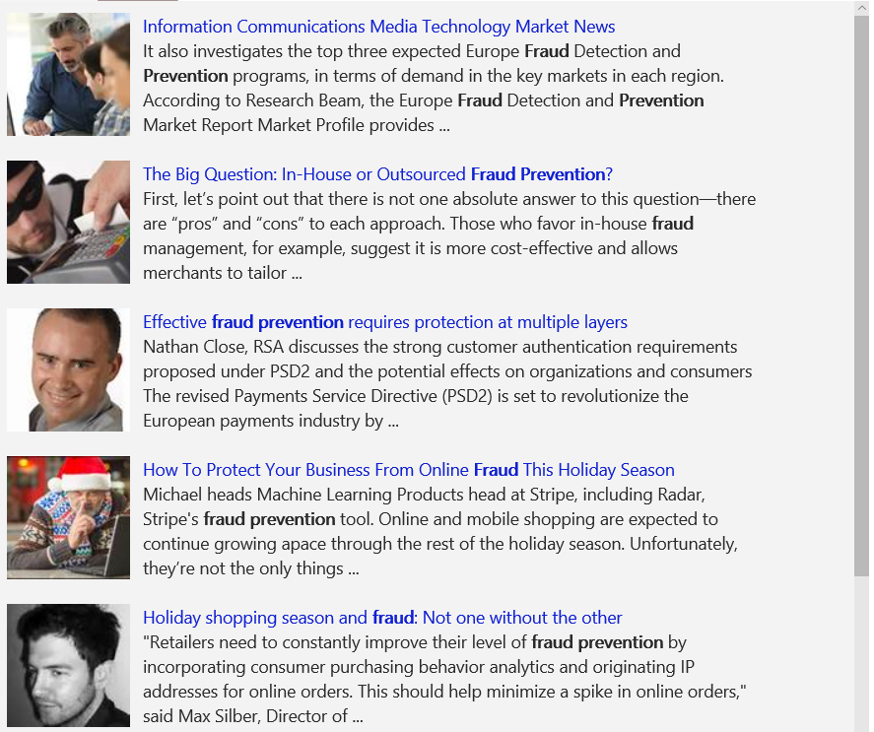
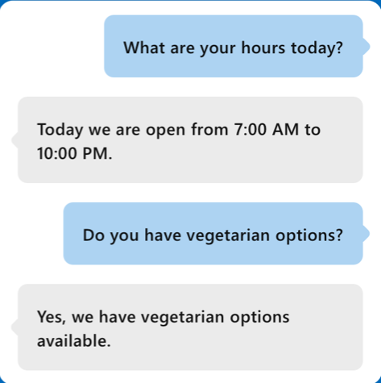
A variety of real-world applications
Vision
Speech
Language
Knowledge
Search
What is in the image or video?
Give me directions to the nearest local branch
Play today’s customer call recording
QnA Pair of this site?
Search for ‘fraud prevention’
Intelligent Image insights
Speech to text
Natural Language Processing
Automatic extraction of questions and answers
Intelligent web search
Information Communications Media Market News
It also investigates the top three expected Fraud Detection and Prevention programs, in terms of demand in key markets…
Intent: PlayCall
Content: Customer#
DateTime.date: today
The Big Question: In-House or Outsourced Fraud Protection?
First, let’s point out that there is not one absolute answer—there are “pros” and “cons” to each. Those who favor in-house…
Category | People; 5 faces
Adult/Racy? | False/False
Dominant colors
Accent color
Convert spoken audio to text
How to Protect Your Business from Online Fraud this Holiday Season
Michael heads fraud prevention tool. Online and mobile shopping are expected to continue growing apace…
Computer Vision
Speech Service
Language Understanding
QnA Maker
Bing News Search
Convert text to spoken audio
Now Playing
Extract intent of user
11/29/2016 Customer Call
Notes:
Cognitive services span Vision, Speech, Language, Knowledge, and Search. Combining many of these services together can either improve user interaction models, or provide fun and engaging user experiences.
Our examples here shine some light on how some of these APIs work in real-world situations:
Vision
The Computer Vision API is able to extract rich information from images to categorize and process visual data and protect your users from unwanted content. Here, the API is able to tell us what the photo contains, indicate the most common colors, and lets us know that the content would not be considered inappropriate for users.
Speech
The Bing Speech API is capable of converting audio to text, understanding intent, and converting text back to speech for natural responsiveness. This case shows us that the user has asked for directions verbally, the intent has been extracted, and a map with directions provided.
Language:
Language Understanding Intelligent Service, known as LUIS, can be trained to understand user language contextually, so your app communicates with people in the way they speak. The example we see here demonstrates Language Understanding’s ability to understand what a person wants, and to find the pieces of information that are relevant to the user’s intent.
Knowledge
Knowledge Exploration Service adds interactive search over structured data to reduce user effort and increase efficiency. Our Knowledge Exploration API example here demonstrates the usefulness of this API for answering questions posed in natural language in an interactive experience.
Search
Bing Image Search API enables you to add a variety of image search options to your app or website, from trending images to detailed insights. Users can do a simple search, and this API scours the web for thumbnails, full image URLs, publishing website info, image metadata, and more before returning results.
Transition: These APIs are available as stand-alone solutions, or as part of the Cortana Intelligence Suite. They can also be used in conjunction with the Microsoft Bot Framework.
<click>

Slide 7
Cognitive Services Available in Power BI These services are available to Power BI dataflows in a “turn key” fashion.
Vision
Speech
Language
Knowledge
Search
Object, scene, and activity detection
Face recognition and identification
Celebrity and landmark recognition
Emotion recognition
Text and handwriting recognition (OCR)
Video metadata, audio, and keyframe extraction and analysis
Explicit or offensive content moderation
Custom image recognition
Speech transcription (Speech-to-text)
Speech Synthesis (Text-to-speech)
Real-time speech translation
Speaker identification and verification
Custom Speech models for transcription and translation
Custom voice
Language detection
Text sentiment analysis
Key phrase extraction
Entity recognition
Spell checking
Explicit or offensive text content moderation, PII detection
Text translation
Customizable text translation
Contextual language understanding
Q&A extraction from unstructured text
Knowledge base creation from collections of Q&As
Semantic matching for knowledge bases
Customizable content personalization learning
Ad-free web, news, image, and video search results
Trends for video, news
Image identification, classification and knowledge extraction
Identification of similar images and products
Named entity recognition and classification
Knowledge acquisition for named entities
Search query autosuggest
Ad-free custom search engine creation
Notes:
While there are a lot of things in Cognitive Services, there are a few things that make a lot of sense for Power BI. Here we’re just calling out the services that are visible to Power BI Dataflows. We’ll focus the rest of the conversation on these services.

Slide 8

Vision
Image-processing algorithms to smartly identify, caption, and moderate your pictures
Notes:
Vision
Computer Vision API: Extract rich information from images to categorize and process visual data – and machine-assisted moderation of images to help curate your services.
Face API: Some potential uses for this technology include facial login, photo tagging, and home monitoring. Or attribute detection to know age, gender, facial hair, etc.
Emotion API: Build an app that responds to moods. Using facial expressions, this cloud-based API can detect happiness, neutrality, sadness, contempt, anger, disgust, fear, and surprise. The AI understands these emotions based on universal facial expressions, and it functions cross-culturally, so your app will work around the world. Some use cases would be an advertising company wants to test user response to an ad, a tv studio wants to track responses to a pilot.
Content Moderator: Image moderation - Enhance your ability to detect potentially offensive or unwanted images through machine-learning based classifiers, custom blacklists, and optical character recognition (OCR).
Text moderation - Helps you detect potential profanity in more than 100 languages and match text against your custom lists automatically. Content Moderator also checks for possible personally identifiable information (PII).
Video moderation - Enable the scoring of possible adult content in videos. Video moderation is currently deployed in preview on Azure Media Services.
Human review tool - Humans can effectively augment machine learning models in situations where the prediction confidence warrants assistance or when decisions must be tempered with a real world context. Enjoy visibility, flexibility and control with a human review tool that supervises the results of your algorithms.
Custom Vision Service: an easy-to-use, customizable web service that learns to recognize specific content in imagery, powered by state-of-the-art machine learning neural networks that become smarter with training. You can train it to recognize whatever you choose, whether that be animals, objects, or abstract symbols. This technology could easily apply to retail environments for machine-assisted product identification, or in digital space to automatically help sorting categories of pictures.
Video Indexer : It helps you unlock insights from any video by indexing and enabling you to search spoken audio that is transcribed and translated, sentiment, faces that appeared and objects. With these insights, you can improve discoverability of videos in your applications or increase user engagement by embedding this capability in sites. All of these capabilities are available through a simple set of APIs, ready to use widgets and a management portal.

Slide 9
Vision
Computer Vision
Video Indexer
Face
Distill actionable information from images
Process and extract smart insights from videos
Detect, identify, analyze, organize, tag faces in photos, and even recognize emotions
Content Moderator
Custom Vision
Machine-assisted moderation of text and images, augmented with human review tools
Customizable web service that learns to recognize specific content in imagery
Notes:
Vision
Computer Vision API: Extract rich information from images to categorize and process visual data – and machine-assisted moderation of images to help curate your services.
Face API: Some potential uses for this technology include facial login, photo tagging, and home monitoring. Or attribute detection to know age, gender, facial hair, etc.
Emotion API: Build an app that responds to moods. Using facial expressions, this cloud-based API can detect happiness, neutrality, sadness, contempt, anger, disgust, fear, and surprise. The AI understands these emotions based on universal facial expressions, and it functions cross-culturally, so your app will work around the world. Some use cases would be an advertising company wants to test user response to an ad, a tv studio wants to track responses to a pilot.
Content Moderator: Image moderation - Enhance your ability to detect potentially offensive or unwanted images through machine-learning based classifiers, custom blacklists, and optical character recognition (OCR).
Text moderation - Helps you detect potential profanity in more than 100 languages and match text against your custom lists automatically. Content Moderator also checks for possible personally identifiable information (PII).
Video moderation - Enable the scoring of possible adult content in videos. Video moderation is currently deployed in preview on Azure Media Services.
Human review tool - Humans can effectively augment machine learning models in situations where the prediction confidence warrants assistance or when decisions must be tempered with a real world context. Enjoy visibility, flexibility and control with a human review tool that supervises the results of your algorithms.
Custom Vision Service: an easy-to-use, customizable web service that learns to recognize specific content in imagery, powered by state-of-the-art machine learning neural networks that become smarter with training. You can train it to recognize whatever you choose, whether that be animals, objects, or abstract symbols. This technology could easily apply to retail environments for machine-assisted product identification, or in digital space to automatically help sorting categories of pictures.
Video Indexer : It helps you unlock insights from any video by indexing and enabling you to search spoken audio that is transcribed and translated, sentiment, faces that appeared and objects. With these insights, you can improve discoverability of videos in your applications or increase user engagement by embedding this capability in sites. All of these capabilities are available through a simple set of APIs, ready to use widgets and a management portal.

Slide 10

Speech
Convert spoken audio into text, use voice for verification, or add speaker recognition to your app
Notes:
Speech APIs provide state-of-the-art algorithms to process spoken language powered by Bing. This also includes speech synthesis for a subset of languages supported by speech recognition. With these APIs developers can easily include the ability to add speech driven actions into their applications. In certain cases, the APIs allow for real-time interaction with the user as well. Additional capabilities include voice recognition and speaker identification as well as providing partial transcription, meaning that for supported languages the developer can get partial results before the user has finished speaking.
Bing Speech API: Convert audio to text, understand intent, and convert text back to speech for natural responsiveness. Converts spoken audio to text. Synthesize Speech - Synthesize audio from Text.
Custom Speech Service: Custom Speech Service (CRIS) enables you to create customized language models and acoustic models tailored to your application and your users. By uploading speech and/or text data to CRIS that reflects your application and your users, you can create custom models that can be used in conjunction with Microsoft’s existing state-of-the-art speech models. To customize the acoustic model to a particular domain, a collection of speech data is required. This collection consists of a set of audio files of speech data, and a text file of transcriptions of each audio file. The audio data should be representative of the scenario in which you would like to use the recognizer. If you were building an app to search MSDN by voice, it’s likely that terms like “object-oriented” or “namespace” or “dot net” will appear more frequently than in typical voice applications. Customizing the language model will enable the system to learn this. CRIS uses acoustic or language model adaptation to enable the speech recognizer to learn the characteristics of the customer’s data while still getting the benefits of all the data and expertise that went into creating the base models that power the Speech API.
For acoustic model adaptation, the technology is described in this paper: http://research.microsoft.com/pubs/194346/0007893.pdf
Works well when the data is uploaded to CRIS is truly representative of the user population and the expected usage of the application. For language model adaptation, it works best when the data uploaded reflects what people would actually say. Uploading simply a list of new terms is better than nothing but will not be as effective. For acoustic model adaptation, if you want to adapt to elderly speech, you need to upload the speech from many different elderly users, not just one or two. If you upload just one person’s voice, CRIS will learn to do a great job on that voice but will not necessarily learn to generalize to other elderly voices. Similarly, if you want to adapt to a new environment, like a factory, you should upload speech data from many speakers in the factory, not just one.
Speaker Recognition API: Microsoft's state-of-the-art cloud-based speaker recognition algorithms to recognize a human's voice in audio streams. It comprises two components: speaker verification and speaker identification. Speaker Verification can automatically verify and authenticate users from their voice or speech. It is tightly related to authentication scenarios and is often associated with a pass phrase. Hence, we opt for text-dependent approach, which means speakers need to choose a specific pass phrase to use during both enrollment and verification phases. Speaker Identification can automatically identify the person speaking in an audio file given a group of prospective speakers. The input audio is paired against the provided group of speakers, and in case there is a match found, the speaker’s identity is returned. It is text-independent, which means that there are no restrictions on what the speaker says during the enrollment and recognition phases. A use case is biometric authentication using voice.

Slide 11
Speech
Speaker Recognition
Translator Speech
Custom Speech
Use speech to identify and verify individual speakers
Easily conduct real-time speech translation with a simple REST API call
Overcome speech recognition barriers like speaking style, background noise, and vocabulary
Unified Speech service
Bing Speech
Unified speech service for speech-to-text (general and custom speech models), text-to-speech (general and custom voice models) and speech translation (general and custom translator)
Convert speech to text and back again to understand user intent
Notes:
Speech APIs provide state-of-the-art algorithms to process spoken language powered by Bing. This also includes speech synthesis for a subset of languages supported by speech recognition. With these APIs developers can easily include the ability to add speech driven actions into their applications. In certain cases, the APIs allow for real-time interaction with the user as well. Additional capabilities include voice recognition and speaker identification as well as providing partial transcription, meaning that for supported languages the developer can get partial results before the user has finished speaking.
Bing Speech API: Convert audio to text, understand intent, and convert text back to speech for natural responsiveness. Converts spoken audio to text. Synthesize Speech - Synthesize audio from Text.
Custom Speech Service: Custom Speech Service (CRIS) enables you to create customized language models and acoustic models tailored to your application and your users. By uploading speech and/or text data to CRIS that reflects your application and your users, you can create custom models that can be used in conjunction with Microsoft’s existing state-of-the-art speech models. To customize the acoustic model to a particular domain, a collection of speech data is required. This collection consists of a set of audio files of speech data, and a text file of transcriptions of each audio file. The audio data should be representative of the scenario in which you would like to use the recognizer. If you were building an app to search MSDN by voice, it’s likely that terms like “object-oriented” or “namespace” or “dot net” will appear more frequently than in typical voice applications. Customizing the language model will enable the system to learn this. CRIS uses acoustic or language model adaptation to enable the speech recognizer to learn the characteristics of the customer’s data while still getting the benefits of all the data and expertise that went into creating the base models that power the Speech API.
For acoustic model adaptation, the technology is described in this paper: http://research.microsoft.com/pubs/194346/0007893.pdf
Works well when the data is uploaded to CRIS is truly representative of the user population and the expected usage of the application. For language model adaptation, it works best when the data uploaded reflects what people would actually say. Uploading simply a list of new terms is better than nothing but will not be as effective. For acoustic model adaptation, if you want to adapt to elderly speech, you need to upload the speech from many different elderly users, not just one or two. If you upload just one person’s voice, CRIS will learn to do a great job on that voice but will not necessarily learn to generalize to other elderly voices. Similarly, if you want to adapt to a new environment, like a factory, you should upload speech data from many speakers in the factory, not just one.
Speaker Recognition API: Microsoft's state-of-the-art cloud-based speaker recognition algorithms to recognize a human's voice in audio streams. It comprises two components: speaker verification and speaker identification. Speaker Verification can automatically verify and authenticate users from their voice or speech. It is tightly related to authentication scenarios and is often associated with a pass phrase. Hence, we opt for text-dependent approach, which means speakers need to choose a specific pass phrase to use during both enrollment and verification phases. Speaker Identification can automatically identify the person speaking in an audio file given a group of prospective speakers. The input audio is paired against the provided group of speakers, and in case there is a match found, the speaker’s identity is returned. It is text-independent, which means that there are no restrictions on what the speaker says during the enrollment and recognition phases. A use case is biometric authentication using voice.

Slide 12
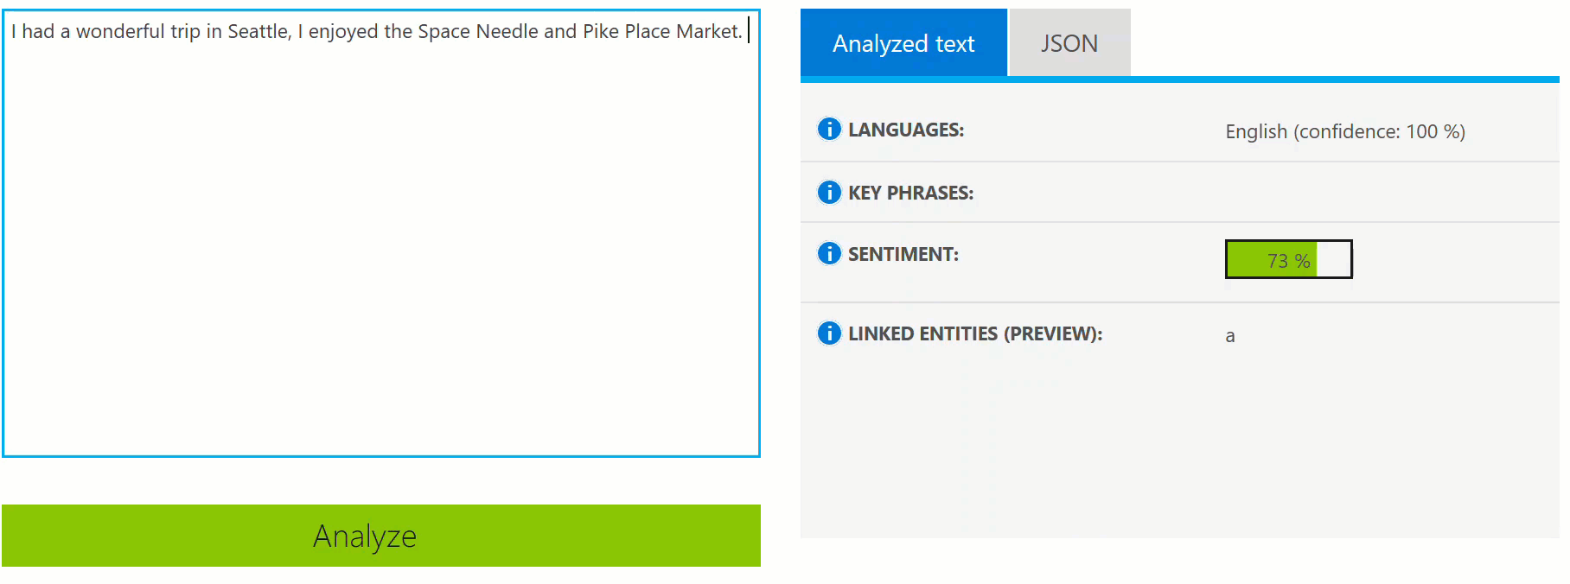
Language
Allow your apps to process natural language with pre-built scripts, evaluate sentiment and learn how to recognize what users want
Notes:
Bing Spell Check API: Microsoft’s state-of-the-art cloud-based spelling algorithms to detect a wide variety of spelling errors and provide accurate suggestions. Using Bing Spell Check, your mobile and PC apps will be powered with state-of-the-art spelling capabilities. Our service is trained on a massive corpus of data gleaned from billions of web pages. There is no need to train your own models. The speller model is updated regularly and incorporates new terms and brands almost as quickly as they appear on the web. This API is available through Microsoft Cognitive Services for customers with low-volume and high-latency jobs. For high-volume and low-latency we have an internal API which may be more suitable. Contact donaldbr directly for more information.
Use cases: 1) Improve the quality of a website's product search 2) provide spell correction for a keyboard app 3) provide spell correction for text fields in an app or web page 4) detect errors in UI text and user data. See https://blogs.msdn.microsoft.com/msr_er/2010/12/15/building-a-better-speller-bing-and-microsoft-research-offer-prizes-for-best-search-engine-spelling-alteration-services/ The speller is exceptional at common spelling errors with low edit-distance (such as febuary->February) but a lot of other spellers are good at that as well. We Do a very good job with word breaking, proper names in context (try "director stephen spielberg") and fictional character names, just a few examples. Areas that are a challenge are capitalization (we don't know what to do with "March" for example, even with context) and consistency (there are times when we will flag a word only intermittently based on the context).
Language Understanding Intelligent Service (LUIS) allows developers to build a model that understands natural language and commands tailored to their application. Example: You can say “turn down the thermostat in the living room,” send it to a LUIS model, and instead of just returning the text that represents what was said, LUIS will return: the action is “turn down,” the location is “living room,” and the target is “thermostat.” LUIS allows developers to iteratively build on these models and take speech or text input and return a structured representation of what the person said. Not only that but by build LUIS will help developers create and train smart conversational bot (Intercom or Slack) with a single button. LUIS will also offer action fulfillment capabilities by simple integration with webhooks. LUIS works pretty well it comes to intents. For the entities, the learning curve is slower especially when the number of entities increases. LUIS only supports 20 intents & 10 entities yet by build each entities can have up to 10 children.
Translator API: Translate speech and text
Language Detection Automatically detect the language of any text string.
Translation Add speech translation, for any of the 9 supported languages, and text translation, for any of the 60 supported languages, to your app.
Text to speech (TTS) Send text strings and receive back the audio version in one of the 19 supported languages.
Custom translation system Build a custom translation system, using as little as 1,000 parallel sentences or start out simply by providing a dictionary of company specific words.
Collaborative translation network Improve translations by creating a specific user group that provides suggestions to improve the translations.
Text Analytics API: The Text Analytics API is a cloud-based service that provides advanced natural language processing over raw text, and includes four main functions: sentiment analysis, key phrase extraction, language detection, and entity linking.

Slide 13
Language
Text Analytics
Bing Spell Check
Detect sentiment, key phrases, language, and extract top entities from your text
Detect and correct spelling mistakes within your app
Translator Text
Language Understanding
Easily perform speech and text translation
Teach your apps to understand commands from your users
Notes:
Bing Spell Check API: Microsoft’s state-of-the-art cloud-based spelling algorithms to detect a wide variety of spelling errors and provide accurate suggestions. Using Bing Spell Check, your mobile and PC apps will be powered with state-of-the-art spelling capabilities. Our service is trained on a massive corpus of data gleaned from billions of web pages. There is no need to train your own models. The speller model is updated regularly and incorporates new terms and brands almost as quickly as they appear on the web. This API is available through Microsoft Cognitive Services for customers with low-volume and high-latency jobs. For high-volume and low-latency we have an internal API which may be more suitable. Contact donaldbr directly for more information.
Use cases: 1) Improve the quality of a website's product search 2) provide spell correction for a keyboard app 3) provide spell correction for text fields in an app or web page 4) detect errors in UI text and user data. See https://blogs.msdn.microsoft.com/msr_er/2010/12/15/building-a-better-speller-bing-and-microsoft-research-offer-prizes-for-best-search-engine-spelling-alteration-services/ The speller is exceptional at common spelling errors with low edit-distance (such as febuary->February) but a lot of other spellers are good at that as well. We Do a very good job with word breaking, proper names in context (try "director stephen spielberg") and fictional character names, just a few examples. Areas that are a challenge are capitalization (we don't know what to do with "March" for example, even with context) and consistency (there are times when we will flag a word only intermittently based on the context).
Language Understanding Intelligent Service (LUIS) allows developers to build a model that understands natural language and commands tailored to their application. Example: You can say “turn down the thermostat in the living room,” send it to a LUIS model, and instead of just returning the text that represents what was said, LUIS will return: the action is “turn down,” the location is “living room,” and the target is “thermostat.” LUIS allows developers to iteratively build on these models and take speech or text input and return a structured representation of what the person said. Not only that but by build LUIS will help developers create and train smart conversational bot (Intercom or Slack) with a single button. LUIS will also offer action fulfillment capabilities by simple integration with webhooks. LUIS works pretty well it comes to intents. For the entities, the learning curve is slower especially when the number of entities increases. LUIS only supports 20 intents & 10 entities yet by build each entities can have up to 10 children.
Translator API: Translate speech and text
Language Detection Automatically detect the language of any text string.
Translation Add speech translation, for any of the 9 supported languages, and text translation, for any of the 60 supported languages, to your app.
Text to speech (TTS) Send text strings and receive back the audio version in one of the 19 supported languages.
Custom translation system Build a custom translation system, using as little as 1,000 parallel sentences or start out simply by providing a dictionary of company specific words.
Collaborative translation network Improve translations by creating a specific user group that provides suggestions to improve the translations.
Text Analytics API: The Text Analytics API is a cloud-based service that provides advanced natural language processing over raw text, and includes four main functions: sentiment analysis, key phrase extraction, language detection, and entity linking.

Slide 14
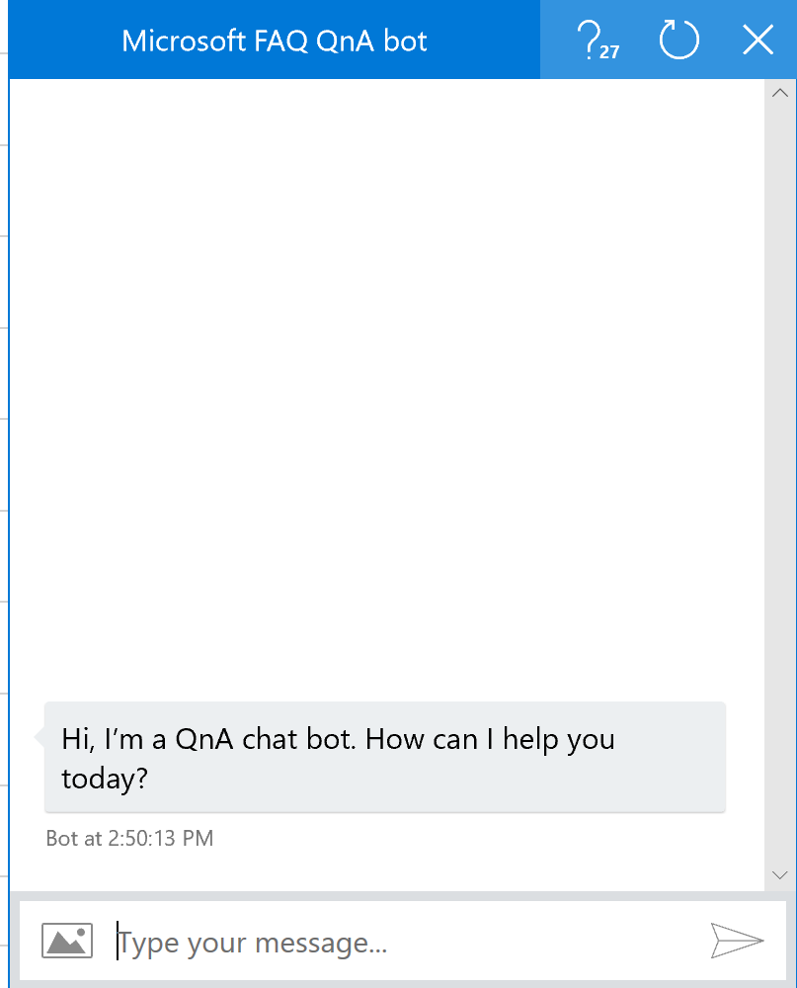
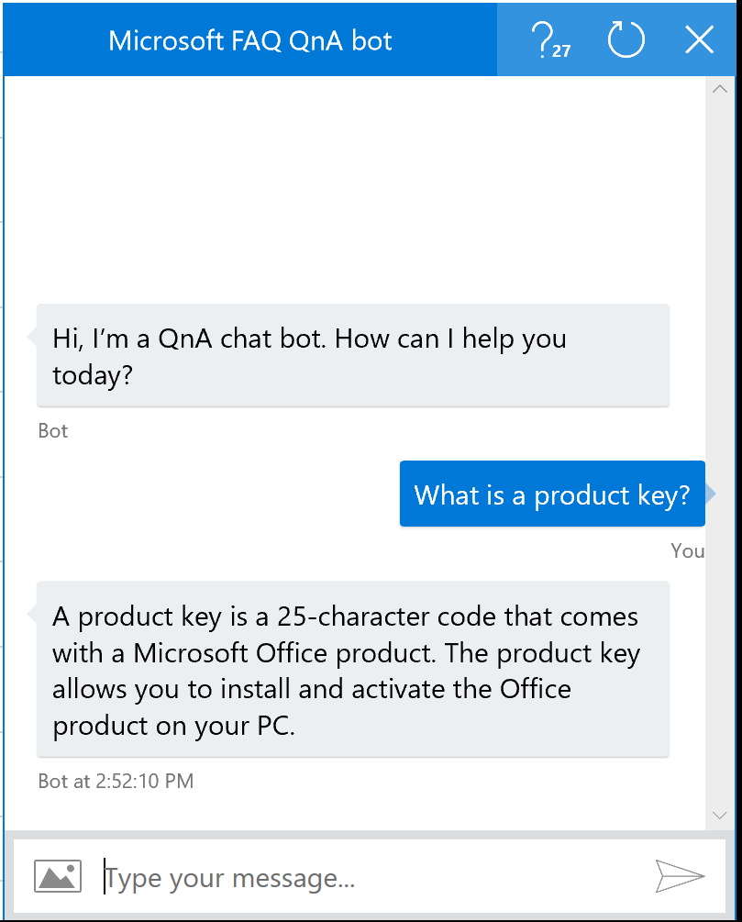
Knowledge
Map complex information and data in order to solve specific tasks
Notes:
Custom Decision Service: a service that helps you create intelligent systems with a cloud-based contextual decision-making API that adapts with experience. Custom Decision service uses reinforcement learning in a new approach for personalizing content; it’s able to plug into your application and helps to make decisions in real time as it automatically adapts to optimize your metrics over time
QnA Maker : Distill information into conversational, easy-to-navigate answers.
Extract questions and answers
QnA Maker extracts all possible pairs of questions and answers from user provided content – FAQ URLs, documents and editorial content.
Test, train and publish
Through QnA Maker’s easy-to-use GUI, you can edit, remove or add pair before testing and training the knowledge base and publishing your knowledge base as an API endpoint.
Integrates with other APIs and solutions
QnA Maker integrates with other APIs seamlessly and at scale. Use QnA Maker with Cognitive Services such as Language Understanding Intelligent Service and create something as elegantly simple as a chat bot that answers FAQs, or as complex as an interactive virtual guide.

Slide 15
Knowledge
Custom Decision
QnA Maker
Create custom experiences with adaptive, contextual decision-making
Distill information into conversational, easy-to-navigate answers
Notes:
Custom Decision Service: a service that helps you create intelligent systems with a cloud-based contextual decision-making API that adapts with experience. Custom Decision service uses reinforcement learning in a new approach for personalizing content; it’s able to plug into your application and helps to make decisions in real time as it automatically adapts to optimize your metrics over time
QnA Maker : Distill information into conversational, easy-to-navigate answers.
Extract questions and answers
QnA Maker extracts all possible pairs of questions and answers from user provided content – FAQ URLs, documents and editorial content.
Test, train and publish
Through QnA Maker’s easy-to-use GUI, you can edit, remove or add pair before testing and training the knowledge base and publishing your knowledge base as an API endpoint.
Integrates with other APIs and solutions
QnA Maker integrates with other APIs seamlessly and at scale. Use QnA Maker with Cognitive Services such as Language Understanding Intelligent Service and create something as elegantly simple as a chat bot that answers FAQs, or as complex as an interactive virtual guide.

Slide 16


Search
Add Bing Search APIs to your apps and harness the ability to comb billions of webpages, images, videos, and news with a single API call
Notes:
The Search APIs provide access to the search technology that power Bing.com and a long list of 1st-party (Office, Cortana, Xbox, Edge) and 3rd-party partners. In total, we have 4 Search APIs for web, image, video and news search. In addition we provide access to our Autosuggest (type-ahead) and Spell Check services.
Bing Web Search API: is the main Search API. With one programmatic call, the user can get back relevant webpage, image, video, and news results. It's equivalent to searching in the web vertical in bing.com. The Search APIs provide the power of the Bing Search engine to developers. You get access to many of the latest and greatest capabilities the bing.com site has to offer, in the form of an API. It's the same architecture stack so it's a powerful way to bring the knowledge and intelligence of the search engine to your own experience. The API is built directly on top of the entire Bing stack- you get the quality, relevance, performance and continuous improvements that the rest of the site gets. Similar to Bing.com- tail queries, or obscure terms may have limited results. We're always working to improve the edge cases though and API users will benefit from that.
Bing Image Search API: Help users scour the web for images. Results include thumbnails, full image URLs, publishing website info, image metadata, and more. Try out the demo.
Bing Video Search API: Find videos across the web. Results provide useful metadata including creator, encoding format, video length, view count, and more
Bing News Search API: Search the web for news articles. Results include details like authoritative image of the news article, related news and categories, provider info, article URL, and date added
Bing Autosuggest API: Help users complete queries faster by adding intelligent type-ahead capabilities to your app or website. Empower users to type less and do more with automated and complete search suggestions.
Bing Custom Search: lets you create a highly-customized web search experience, which delivers better and more relevant results from your targeted web space. Featuring a straightforward User Interface, Bing Custom Search enables you to create your own web search service without a line of code. Specify the slices of the web that you want to draw from and explore site suggestions to intelligently expand the scope of your search domain. Bing Custom Search can empower businesses of any size, hobbyists and entrepreneurs to design and deploy web search applications for any possible scenario.
Bing Entity Search API - Search for the most relevant entity
Harness the power of the web with the Bing Entity Search API. You can enrich your app by infusing knowledge search into existing content. Bing Entity Search API will identify the most relevant entity based on your searched term, spanning multiple entity types such as famous people, places, movies, TV shows, video games, books, and even local businesses near you.
Bing Visual Search - a new service in general availability that lets you harness the capabilities of Bing Search to perform intelligent search by image capabilities, such as searching similar products for a given product (e.g. in retail scenario, wherein user would like to see products similar to the one being considered), identifying barcodes, text, celebrities and more!
Bing Statistics-add-in - an add-in which provides various metrics and rich slicing and dicing capabilities for several Bing APIs

Slide 17
Search
Bing Search
Bing Visual Search
Bing Entity Search
Web Search
Image Search
News Search
Video Search
Get rich insights to help build compelling image applications on the device of your choice
Enrich user experiences with contextual entity search results
Bing Autosuggest
Bing Custom Search
Give your app intelligent autosuggest options for searches
Create a highly-customized web search experience
Bing Statistics add-in
Get powerful Bing API usage insights in an easy-to-use add-in
Notes:
The Search APIs provide access to the search technology that power Bing.com and a long list of 1st-party (Office, Cortana, Xbox, Edge) and 3rd-party partners. In total, we have 4 Search APIs for web, image, video and news search. In addition we provide access to our Autosuggest (type-ahead) and Spell Check services.
Bing Web Search API: is the main Search API. With one programmatic call, the user can get back relevant webpage, image, video, and news results. It's equivalent to searching in the web vertical in bing.com. The Search APIs provide the power of the Bing Search engine to developers. You get access to many of the latest and greatest capabilities the bing.com site has to offer, in the form of an API. It's the same architecture stack so it's a powerful way to bring the knowledge and intelligence of the search engine to your own experience. The API is built directly on top of the entire Bing stack- you get the quality, relevance, performance and continuous improvements that the rest of the site gets. Similar to Bing.com- tail queries, or obscure terms may have limited results. We're always working to improve the edge cases though and API users will benefit from that.
Bing Image Search API: Help users scour the web for images. Results include thumbnails, full image URLs, publishing website info, image metadata, and more. Try out the demo.
Bing Video Search API: Find videos across the web. Results provide useful metadata including creator, encoding format, video length, view count, and more
Bing News Search API: Search the web for news articles. Results include details like authoritative image of the news article, related news and categories, provider info, article URL, and date added
Bing Autosuggest API: Help users complete queries faster by adding intelligent type-ahead capabilities to your app or website. Empower users to type less and do more with automated and complete search suggestions.
Bing Custom Search: lets you create a highly-customized web search experience, which delivers better and more relevant results from your targeted web space. Featuring a straightforward User Interface, Bing Custom Search enables you to create your own web search service without a line of code. Specify the slices of the web that you want to draw from and explore site suggestions to intelligently expand the scope of your search domain. Bing Custom Search can empower businesses of any size, hobbyists and entrepreneurs to design and deploy web search applications for any possible scenario.
Bing Entity Search API - Search for the most relevant entity
Harness the power of the web with the Bing Entity Search API. You can enrich your app by infusing knowledge search into existing content. Bing Entity Search API will identify the most relevant entity based on your searched term, spanning multiple entity types such as famous people, places, movies, TV shows, video games, books, and even local businesses near you.
Bing Visual Search - a new service in general availability that lets you harness the capabilities of Bing Search to perform intelligent search by image capabilities, such as searching similar products for a given product (e.g. in retail scenario, wherein user would like to see products similar to the one being considered), identifying barcodes, text, celebrities and more!
Bing Statistics-add-in - an add-in which provides various metrics and rich slicing and dicing capabilities for several Bing APIs

Slide 18
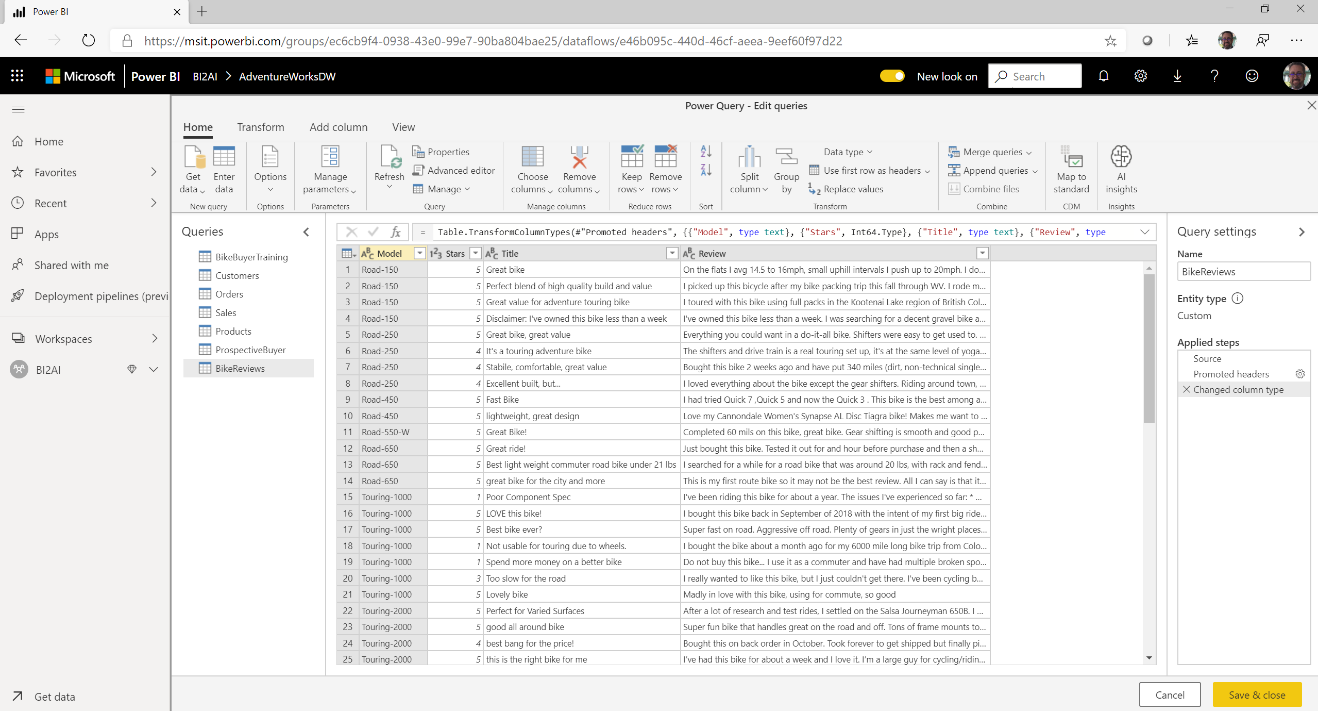

Slide 19
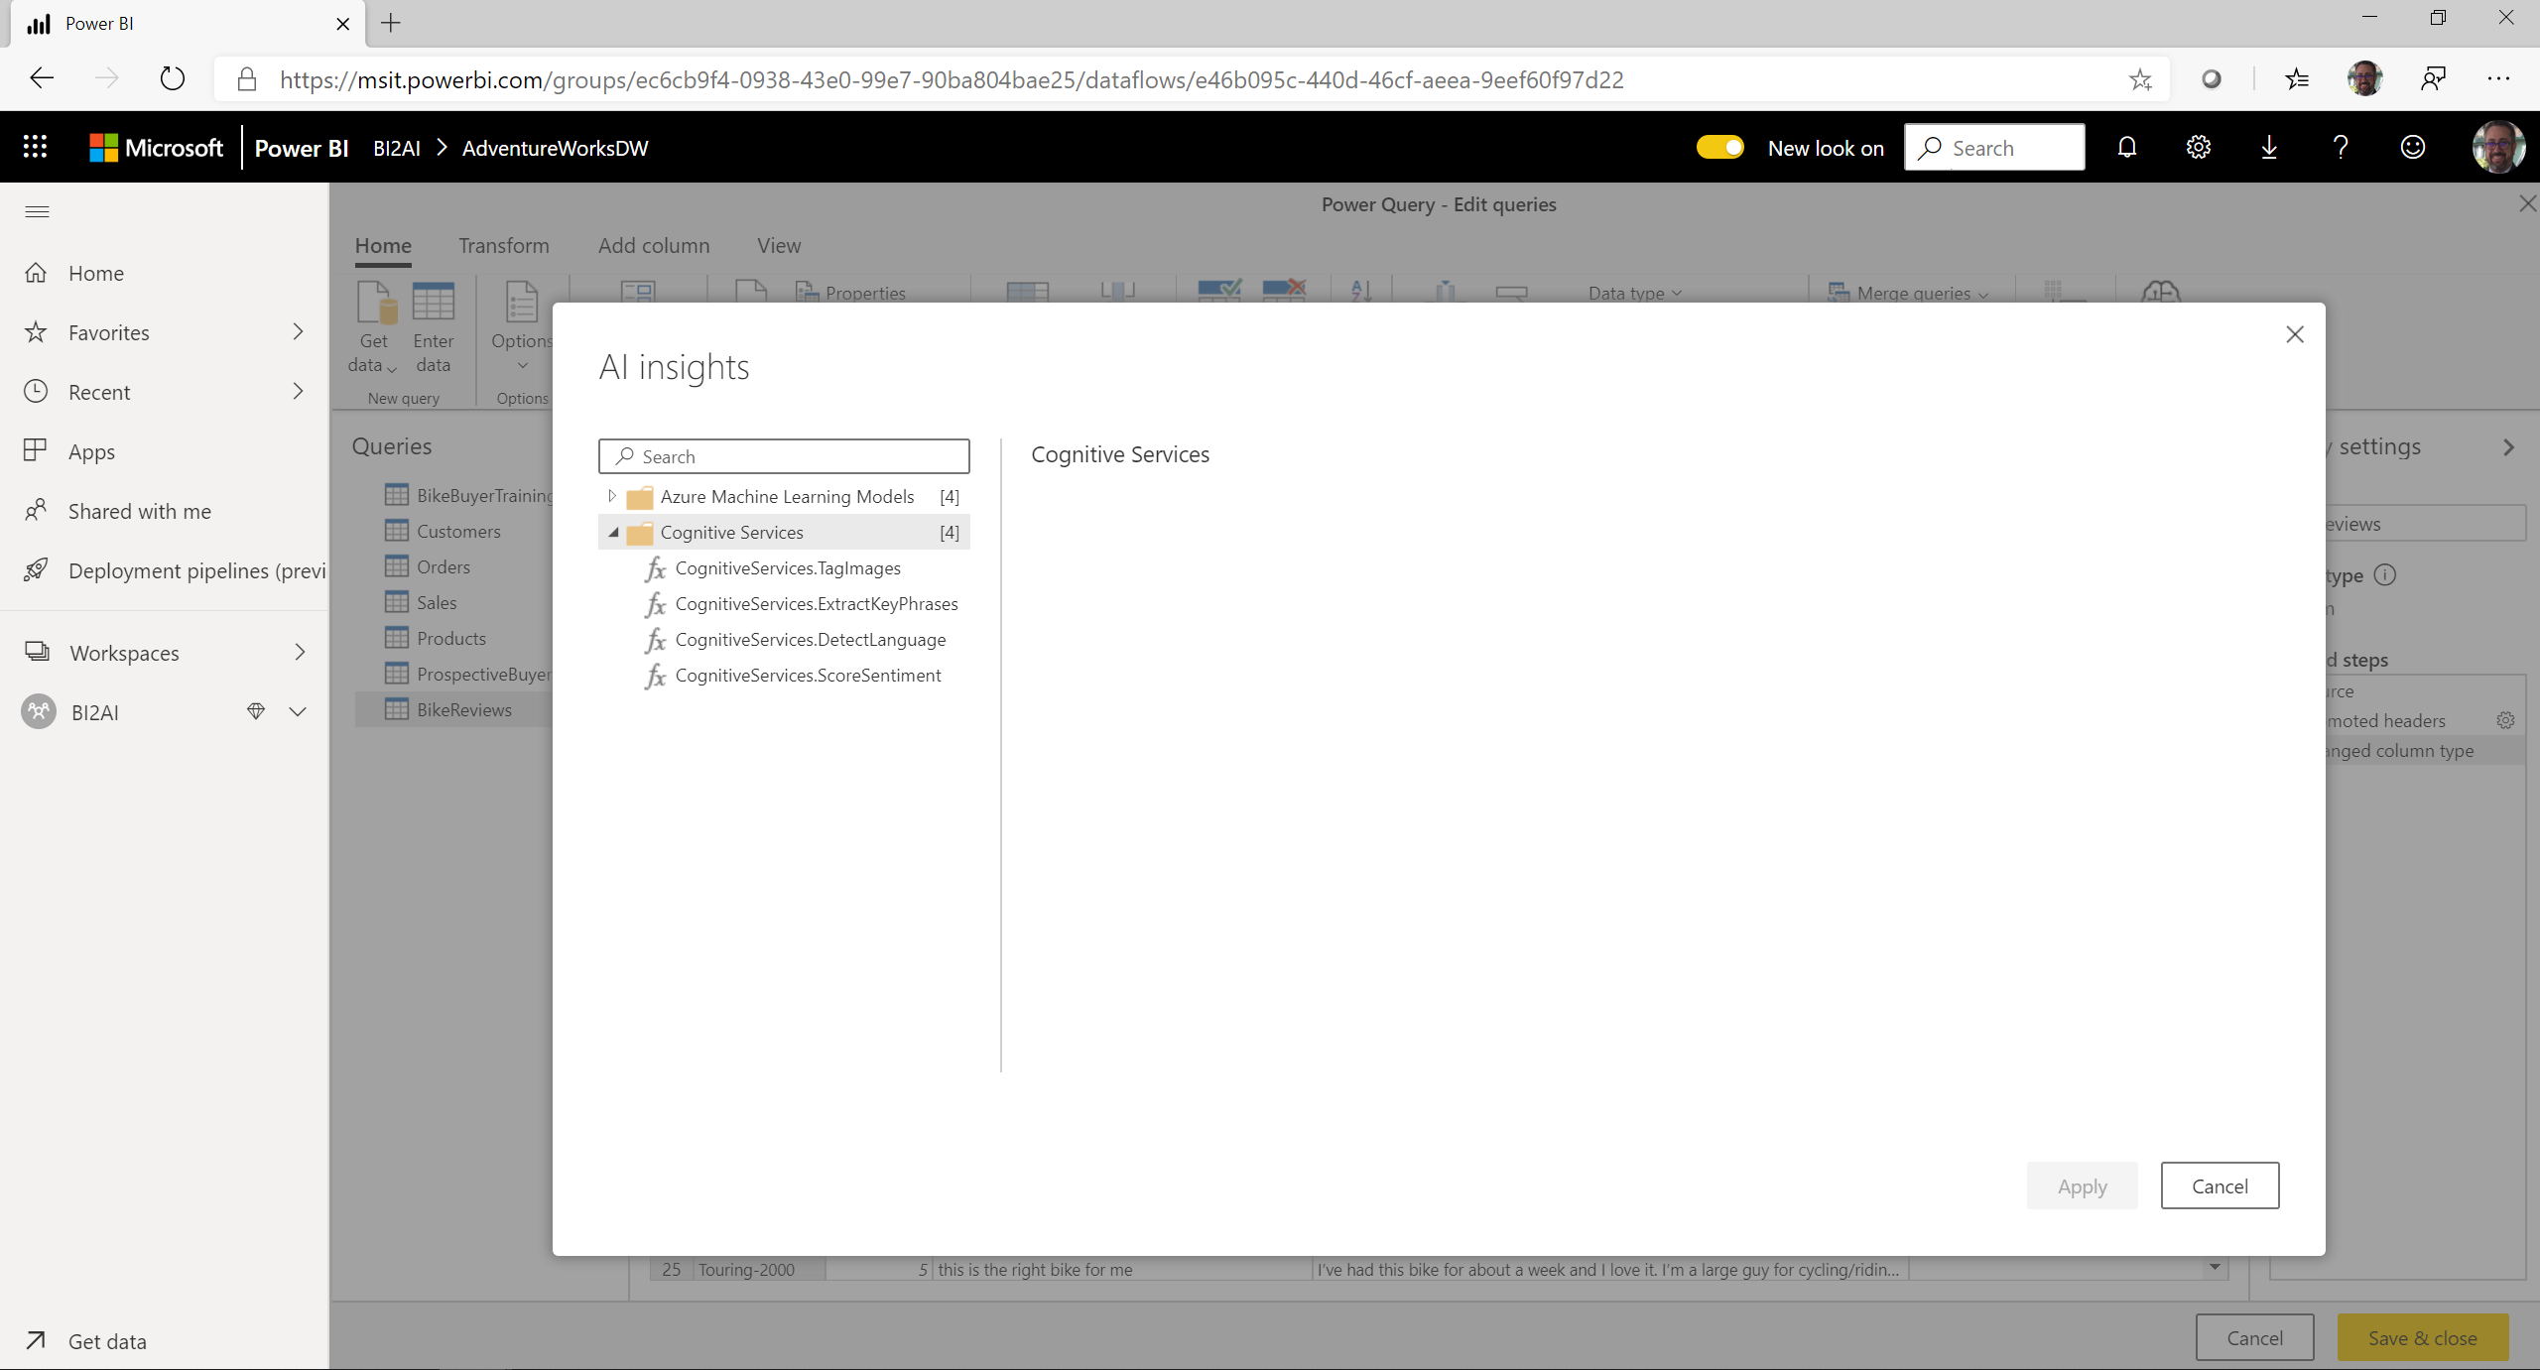

Slide 20
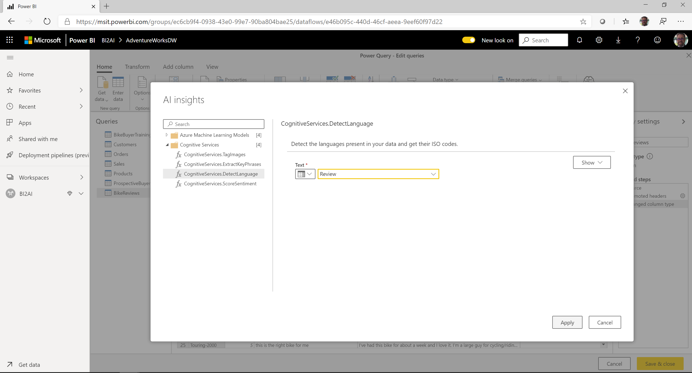

Slide 21
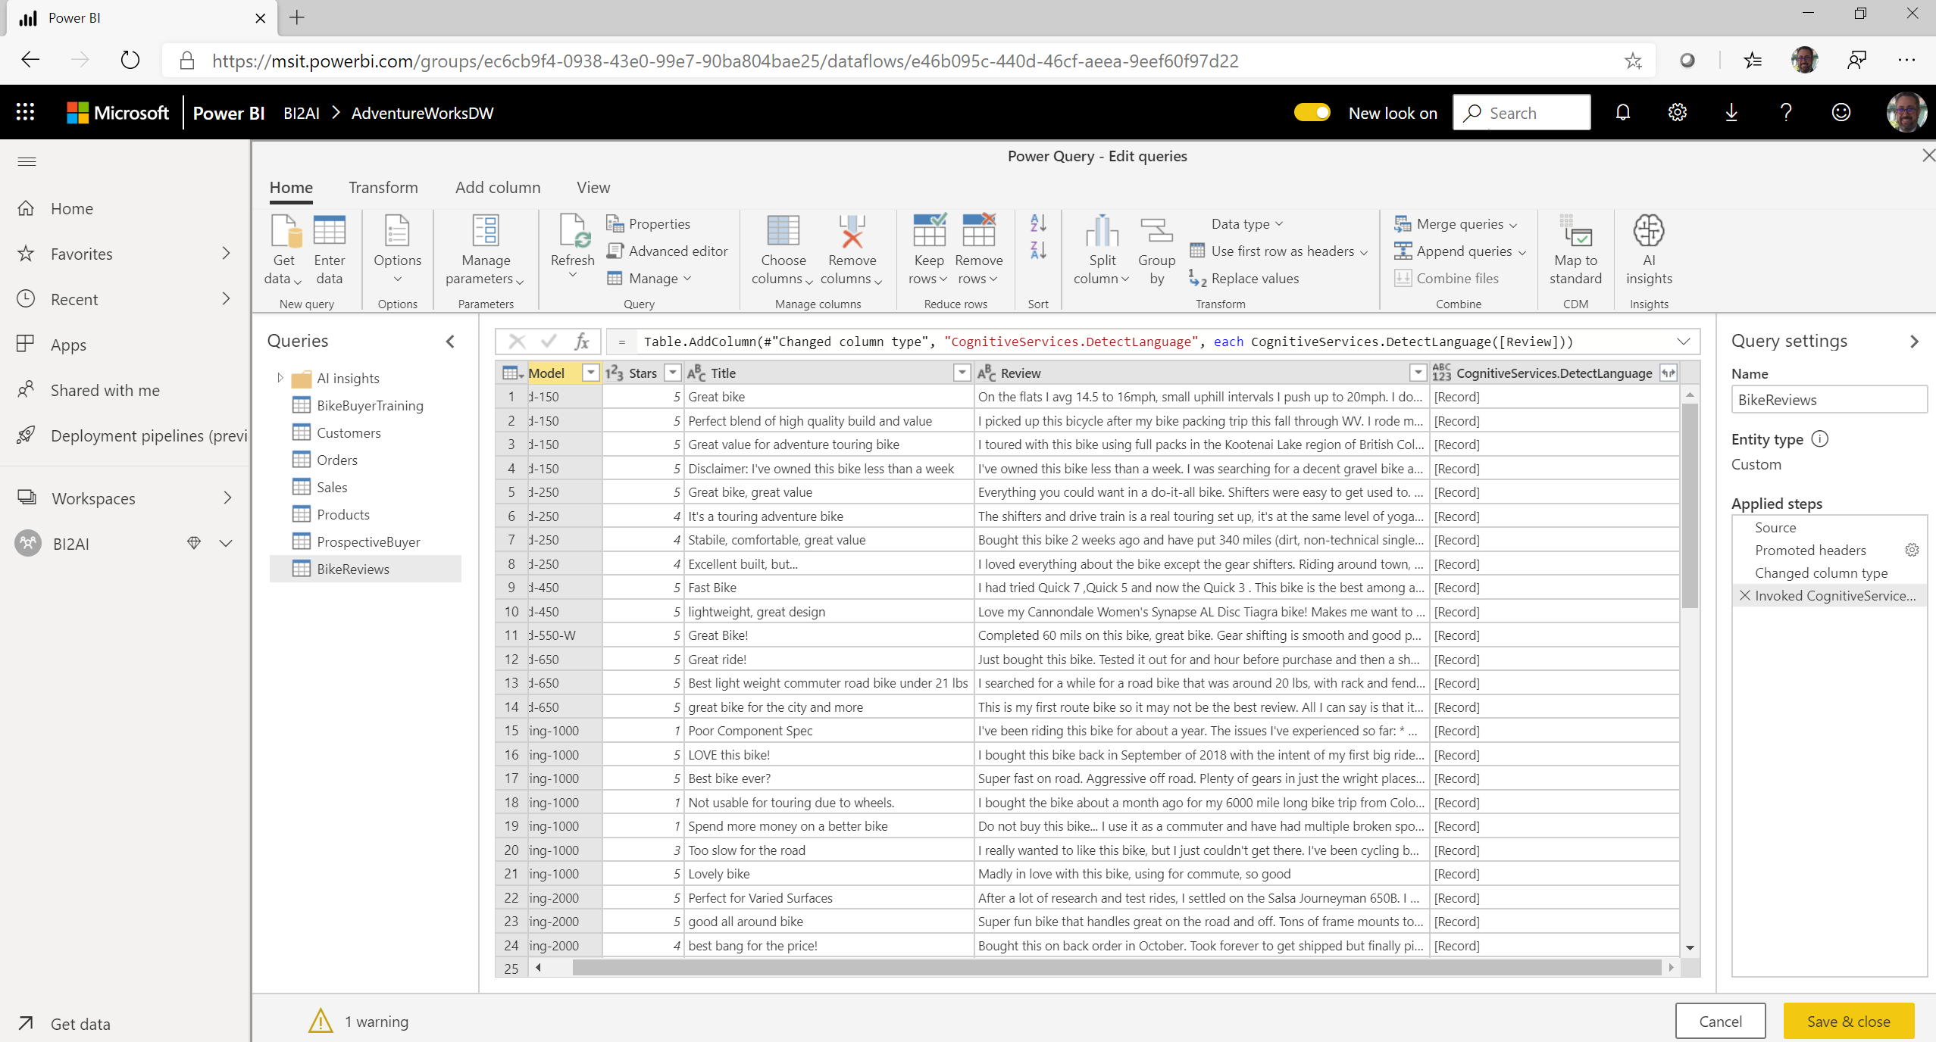

Slide 22
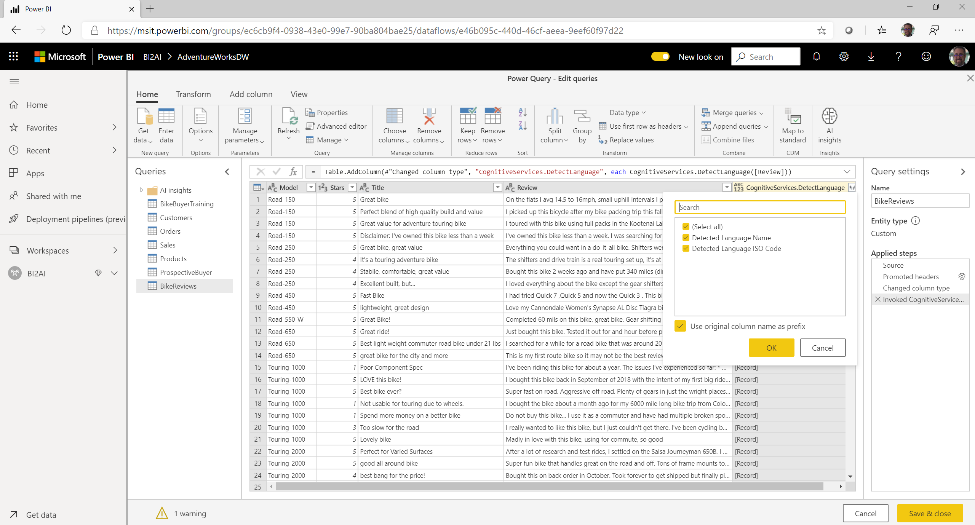

Slide 23

Get started for free at http://azure.com/Cognitive
Learn more on the Cognitive Services documentation
Schedule a workshop to identify areas in your business where analytics and intelligence can drive transformation
Talk with your Microsoft contact about licensing options and partners

Slide 24
Developer resources
Pricing
https://azure.microsoft.com/en-us/pricing/details/cognitive-services/
Documentation
https://docs.microsoft.com/en-us/azure/#pivot=products&panel=cognitive
Client SDKs
https://azure.microsoft.com/en-us/resources/samples/?sort=0&term=cognitive+services https://github.com/southwood/project-oxford-python
Example Code
https://github.com/jsturtevant/happy-image-tester-django
https://github.com/Microsoft/Cognitive-Face-Android https://github.com/Microsoft/Cognitive-Samples-IntelligentKiosk
Join Our Community
https://stackoverflow.com/questions/tagged/microsoft-cognitive
https://cognitive.uservoice.com/
Notes:
Access to strong documentation, sample code and community resources is critical for developers to be able to understand and become users of Cognitive Services. Customize these links based on your own resources or use the ones listed here.

